Slide 1




Data Visualization Project
Final Presentation
T20 Cricket Analysis Dashboard
Group - B

Slide 2
Data Visualization Project
Final Presentation
T20 Cricket Analysis Dashboard
Group - B

Slide 3
Introduction
Our Project is based on the 2022 T20 World cup of men.
And that tournament was held on Australia.
Also, in 2022 T20 champions are England

Slide 4
Objectives
Making insightful dashboard for the 2022 T20 men's world cup.
Doing more useful EDA Process.

Slide 5
Techniques Used
EDA Part : Python
Dashboard Creation : Power BI

Slide 6
EDA Part
Here we mainly focus two sides.
They are:
Batting Performance
Bowling Performance

Slide 7
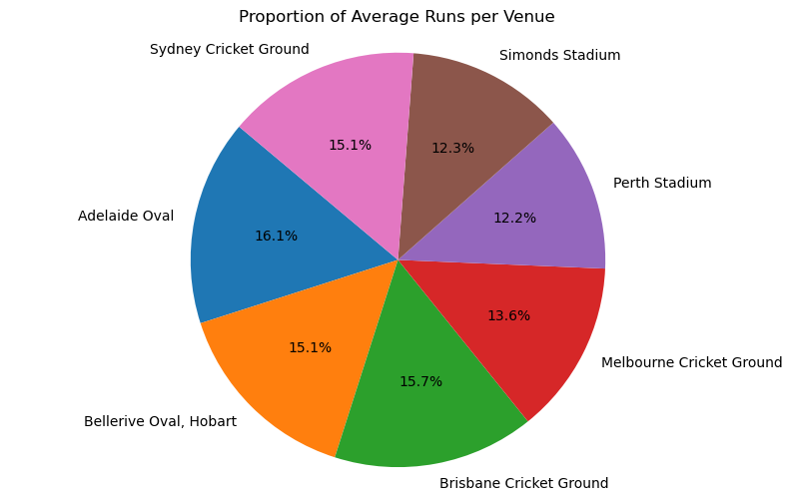
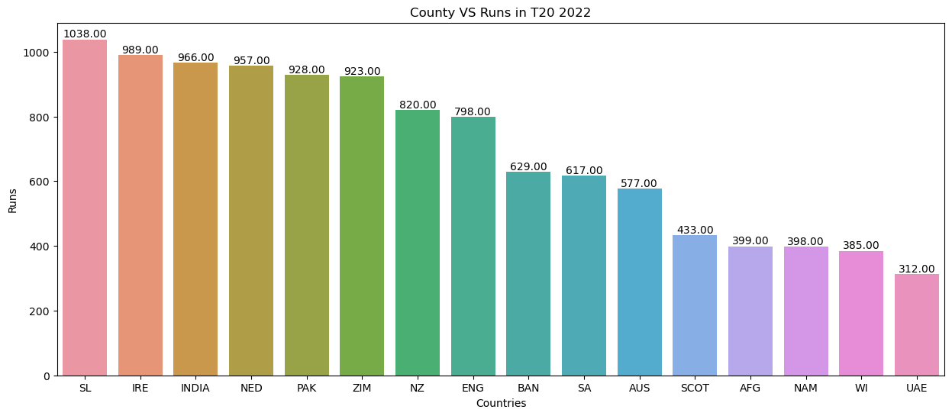
Batting Performance

Slide 8
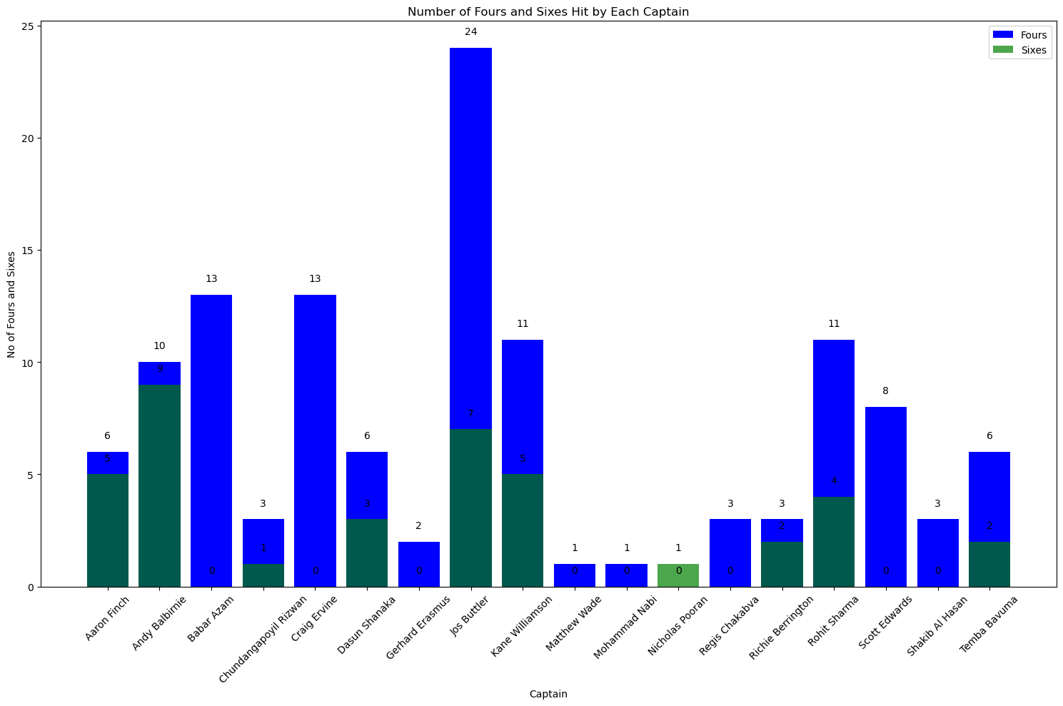
Batting Performance

Slide 9
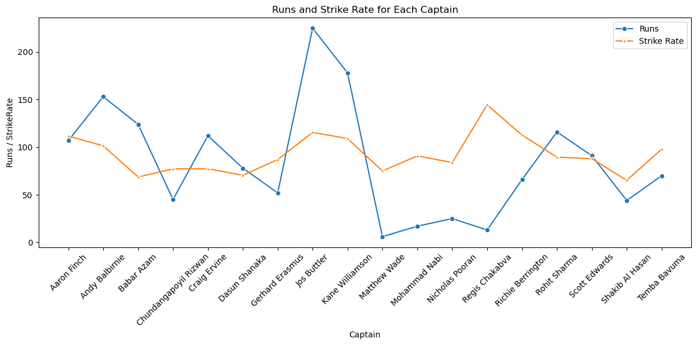
Batting Performance

Slide 10
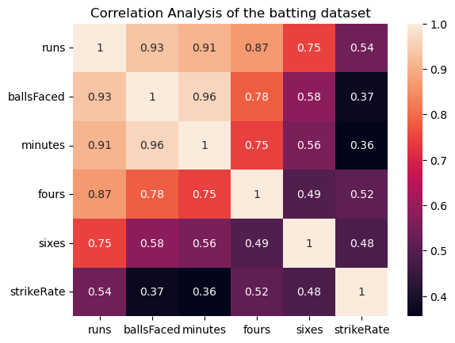
Batting Performance

Slide 11
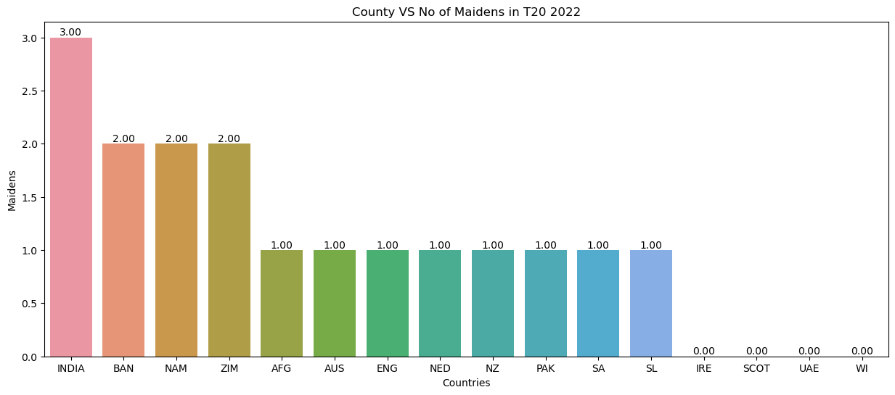
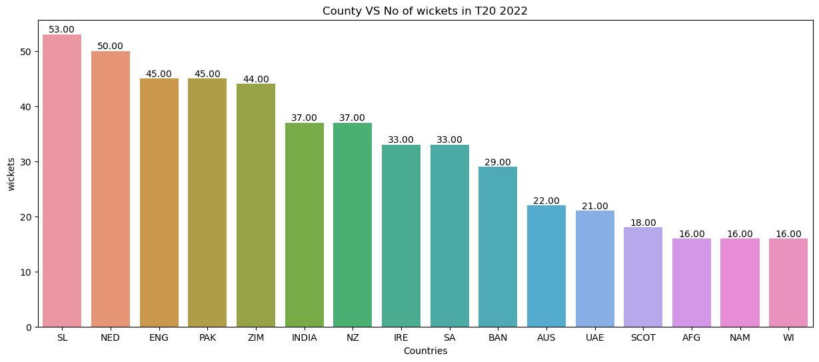
Bowling Performance

Slide 12
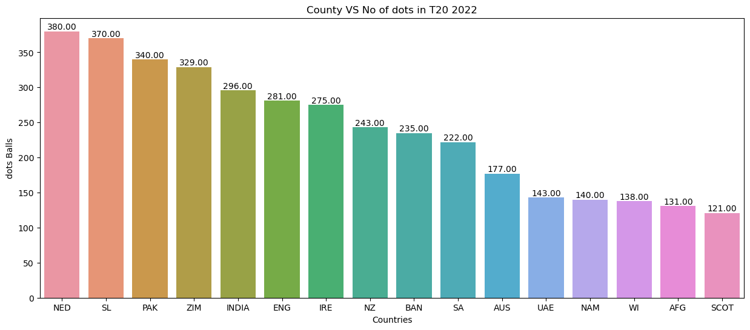
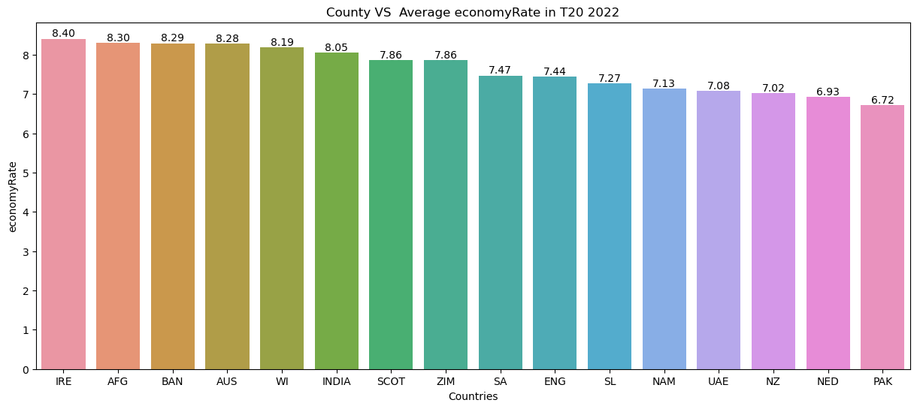
Bowling Performance

Slide 13
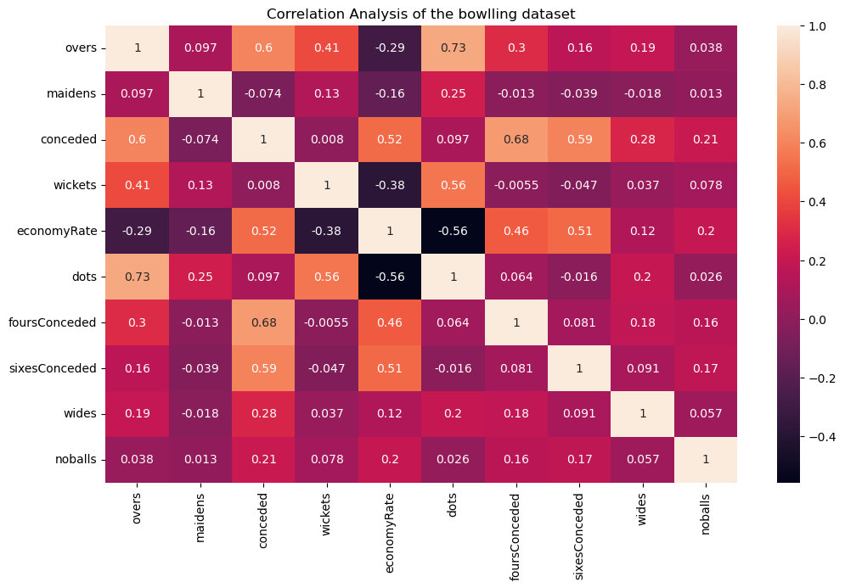
Bowling
Performance

Slide 14
Let’s See Our Dashboard

